Slide 1
Al-based tool for preliminary diagnosis of Dermatological manifestations
CSE7101- Capstone Project
Review-1
Batch Number: 13
Under the Supervision of,
Dr. Megala G
Assistant Professor
School of Computer Science and Engineering
Presidency University
Roll Number | Student Name
20221CSE0615 | NAMAN KUMAR
20221CSE0616 | SRREEJA KN
20221CSE0535 | SANKARSHAN
Name of the Program: B TECH
Name of the HoD: Dr. Asif Mohammed , Dr. Blessed Prince
Name of the Program Project Coordinator:
Name of the School Project Coordinators: Dr. Sampath A K , Dr. Geetha A

Slide 2
Problem Statement Number:
Organization: Ministry of AYUSH
Category (Hardware / Software / Both) : Software
Problem Description:
Smart Education Platform for Personalized Curricula

Slide 3
PROBLEM STATEMENT
Smart Education Platform for Personalized Curricula
The current higher education system often lacks flexibility, forcing students into rigid, standardized curricula that may not align with their individual interests or career goals. This can lead to a less engaging learning experience and may fail to adequately prepare students for a rapidly evolving, interdisciplinary job market. Existing educational platforms and Learning Management Systems (LMS) primarily focus on content delivery for predefined courses, offering limited options for customization, interdepartmental course selection, or student-driven project work.

Slide 4
OBJECTIVES
This project aims to address this gap by developing a Smart Education Platform that empowers undergraduate students to design their own personalized and interdisciplinary curricula. The platform will provide a flexible and efficient learning environment where students can:
Select courses from various departments within their college.
Integrate external courses from reputable sources like NPTEL.
Choose their own faculty guide for projects, allowing for specialized, hands-on learning experiences that count as formal subjects.

Slide 5
Flow of work
Start → Phase 1 → Phase 2 → Phase 3 → Phase 4 → Phase 5 → End
Phase 1: Planning & Setup Repo setup | Env config | Schema design | Project structure
Phase 2: Backend Express.js APIs | Auth (JWT + bcrypt) | CRUD ops | MongoDB
Phase 3: Frontend React UI | Auth forms | Dashboard | State mgmt (Redux/Context) | API calls
Phase 4: Core Features Curriculum Builder | Project Allocation (faculty approval) | Grades submission | (Optional: NPTEL API)
Phase 5: Testing & Deployment Unit + E2E Tests | UI polish | Deploy FE (Netlify/Vercel) + BE (Heroku/AWS)

Slide 6
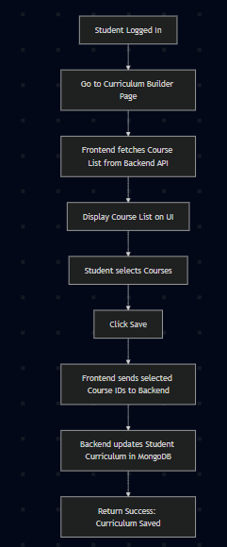
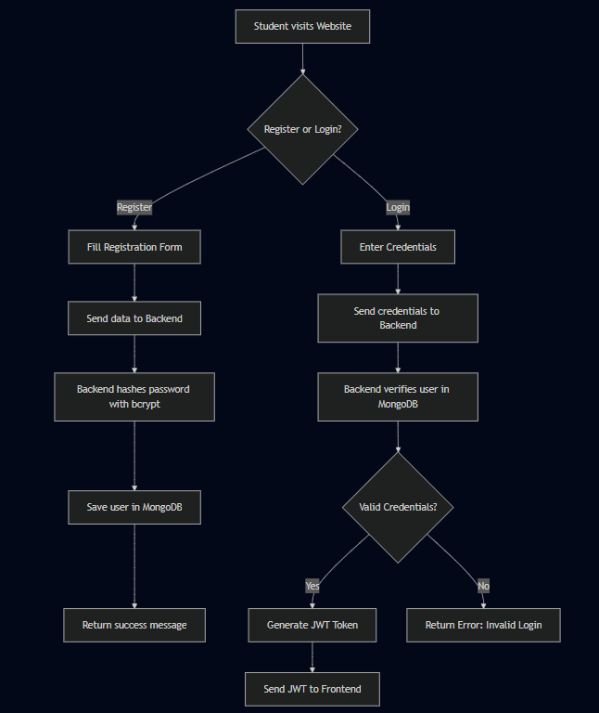
Login flow

